Slide 1
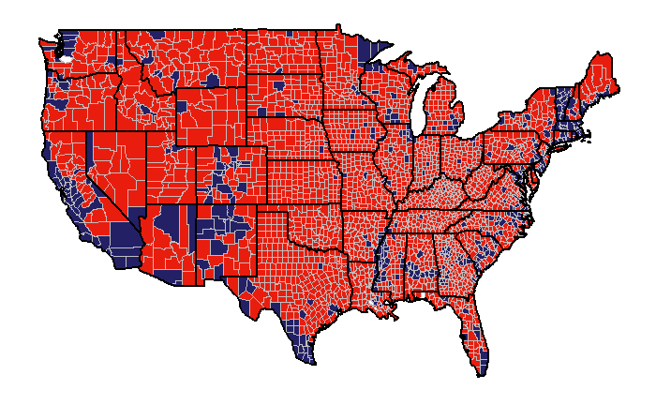
2016 US Election: County Analysis

Slide 2
Introduction
Purpose of study
Determine the reason behind the switch from Democrats to Republicans in the 2016 US election on a county level
Why use counties?
Provides a segmentation of the United States
Cons of using counties?
Voting habits and characteristic of individuals are masked
Provides a proxy for individual voting habits
Demographic and voting results available

Slide 3
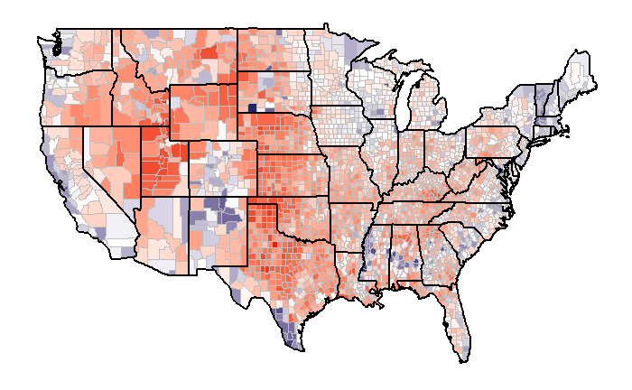
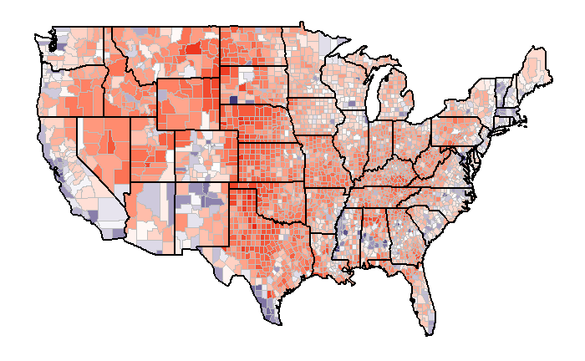

2012 and 2016 Election Summary: Outcome
2012 Election
2016 Election
Percent Differences
2012 County Results | Number of Counties | Percentage of Total
Republican Majority | 2426 | 78%
Democrat Majority | 686 | 22%
2016 County Results | Number of Counties | Percentage of Total
Republican Majority | 2624 | 84%
Democrat Majority | 488 | 16%

Slide 4

2012 and 2016 Election Summary: County Conversion
Of the 686 counties that voted Democrat in 2012:
218 voted for Republican in 2016
468 voted for Democrat in 2016
Of the 2,426 counties that voted Republican in 2012:
2,406 voted for Republican in 2016
20 voted for Democrat in 2016
Percent Conversion
FROM / TO | Republican | Democrat
Republican | 99.2% | 0.8%
Democrat | 31.8% | 68.2%
Why the Democrats Lost?
Almost no conversion from Republican to Democrat
Gained no new base
Many counties switched from Democrat to Republican

Slide 5
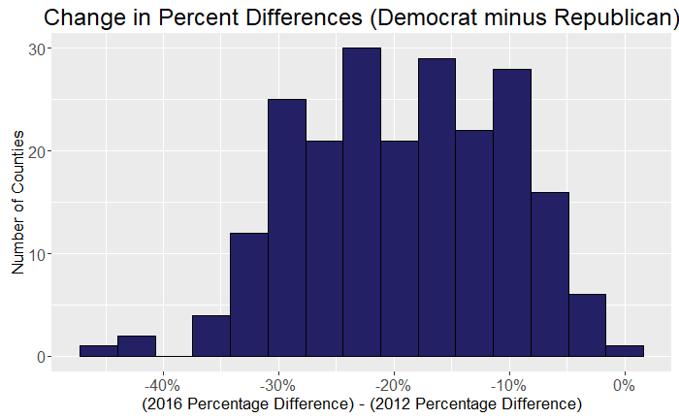
2012 and 2016 Election Summary: Concerns for Democrats
Concerns
In counties that converted, the difference between the number of votes received by Democrats and Republicans increased by a large amount
Why did some counties switch while others didn’t?
Do these counties share certain characteristics?
Did the Democrats lose a core base?

Slide 6
Group Comparison: Definition
Divide counties into two groups:
1. Switched Counties
Democrat majority in 2012
Change in percent difference decreased by at least 5%
Republican majority in 2016
2. Remained Counties
Democrat majority in 2012
Change in percent difference did not decreased by at least 5%
Democrat majority in 2016
Are there characteristic differences between these two groups?

Slide 7
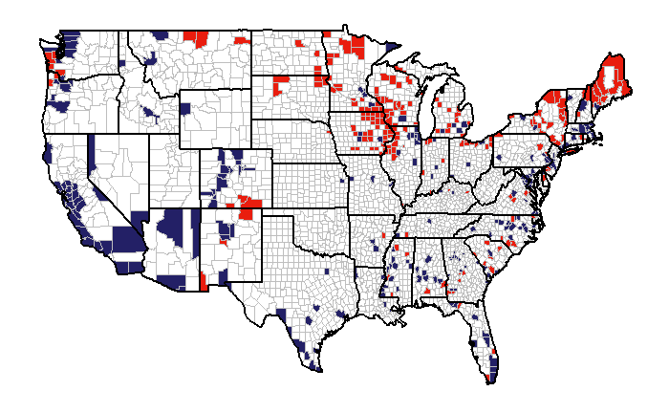
Group Comparison: Geographic Location
Switched Counties
Geography concentrated in the Midwest and Northeast
210 counties in total
Remained Counties
Geography concentrated in coastal regions
270 counties in total

Slide 8
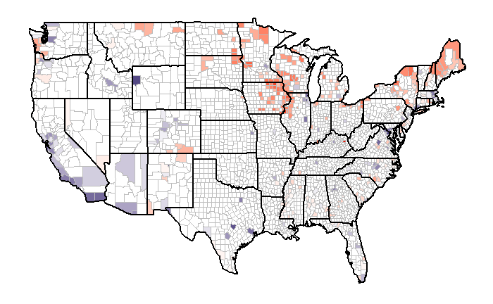

Group Comparison: Geographic Location
Switched Counties
Two key regions with largest change
Percent Change

Slide 9
Group Comparison: Group Description
Population Factors | Mean |  | Median
 | Switched | Remained | Switched | Remained
Population Size | 75,078 | 515,284 | 31,731 | 266,102
Population Density | 176 | 1,782 | 41.5 | 566
4-year Population Change | -1.0% | 3.1% | -1.1% | 3.2%
Living in Same Place for +1 years | 87.7% | 83.1% | 88.0% | 83.7%
Multi-unit Housing | 13.8% | 27.8% | 12.7% | 26.6%
Switched counties tend to:
Be less densely populated
Have declining populations

Slide 10
Group Comparison: Group Description
Age Factors | Mean |  | Median
 | Switched | Remained | Switched | Remained
Less than 18 | 21.7% | 22.3% | 21.6% | 22.4%
Between 18 and 65 | 54.4% | 57.7% | 54.4% | 56.7%
More than 65 | 18.3% | 13.9% | 18.2% | 13.5%
Switched counties tend to:
Have older populations
Education Factors | Mean |  | Median
 | Switched | Remained | Switched | Remained
Completed High School | 86.7% | 86.0% | 88.1% | 87.6%
Completed Bachelors Degree | 18.8% | 33.2% | 17.8% | 32.2%
Switched counties tend to:
Be less educated

Slide 11
Group Comparison: Group Description
Housing Factors | Mean |  | Median
 | Switched | Remained | Switched | Remained
Homeownership Rate | 73.2% | 61.6% | 73.4% | 62.4%
Median House Value | 123,471 | 242,116 | 115,550 | 208,050
Household Size | 2.46 | 2.60 | 2.43 | 2.55
Switched counties tend to:
Have higher homeownership rates
Have lower house values
Income Factors | Mean |  | Median
 | Switched | Remained | Switched | Remained
Income Per Capita | 23,670 | 28,775 | 24,069 | 27,701
Median Income Per Household | 46,012 | 54,713 | 46,109 | 52,363
Switched counties tended to:
Have lower Incomes

Slide 12
Group Comparison: Group Description
Ethnic Factors | Mean |  | Median
 | Switched | Remained | Switched | Remained
White | 79.9% | 54.9% | 86.3% | 55.7%
Black or African American | 8.7% | 21.5% | 2.0% | 12.2%
Hispanic or Latino | 5.9% | 16.5% | 3.1% | 9.0%
Asian | 1.0% | 4.9% | 0.7% | 3.5%
Foreign Born | 3.2% | 12.3% | 2.3% | 9.5%
Speak second language | 6.7% | 20.1% | 4.9% | 13.4%
Switched counties tend to:
Be more white
Have fewer immigrants

Slide 13
Group Comparison: Group Description
Economic Factors | Mean |  | Median
 | Switched | Remained | Switched | Remained
Nonfarm Employment per Capita | 0.279 | 0.389 | 0.272 | 0.375
Retail Sales ($1000) per Capita | 10.088 | 13.171 | 10.225 | 12.433
Wholesaler Sales ($1000) per Capita | 6.556 | 9.884 | 3.318 | 6.889
Acc. & Food services sales ($1000) per Capita | 1.211 | 2.486 | 0.965 | 1.844
Manufacturers Shipments ($1000) per Capita | 14.992 | 11.797 | 12.572 | 8.822
Switched counties tend to:
Have more farm employment
Economies more focused on manufacturing
Economies less focused on service industry

Slide 14
Group Comparison: Group Differences Summary
Relative to the Remained counties, Switched counties tend to:
Be less educated
Be more rural
Have Economies more focused in farming and manufacturing
Have an older population
Be more white and have less immigrants
Tend to be located in the Midwest and Northeast

Slide 15
Group Comparison: Predicting Conversion
Goal
Determine what factors are the key predictors of whether a county switched
Tool
Logistic regression
Results: Model accuracy of 96%
Key Factors
1. Race:
Higher Probability of Switch
Higher percentage of white population
2. Education:
Higher Probability of Switch
Lower percentage of population holding Bachelors
3. Rural:
Higher Probability of Switch
More rural or declining populations
4. Gender:
Higher Probability of Switch
Lower percentage of women

Slide 16
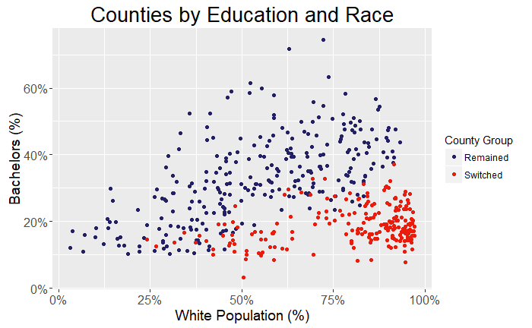
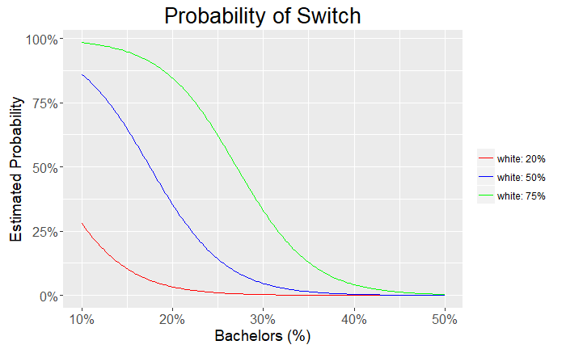
Group Comparison: Relationship between Race and Education
Percentage of county population that are white or have bachelor degrees is a strong predictor
White and uneducated counties overwhelmingly switched
A model with only white and bachelor percentage has a prediction accuracy of roughly 95%

Slide 17
Recommendations
Comments to Democrats
From a county perspective, the driving force behind the lost was the lost of a core group
This group will continue to have a dramatic impact in future elections
Recommendations to Democrats
Investigate this group to determine what factors are driving them away
This group no longer believes that Democrats have their best interest at heart

